Slide 1
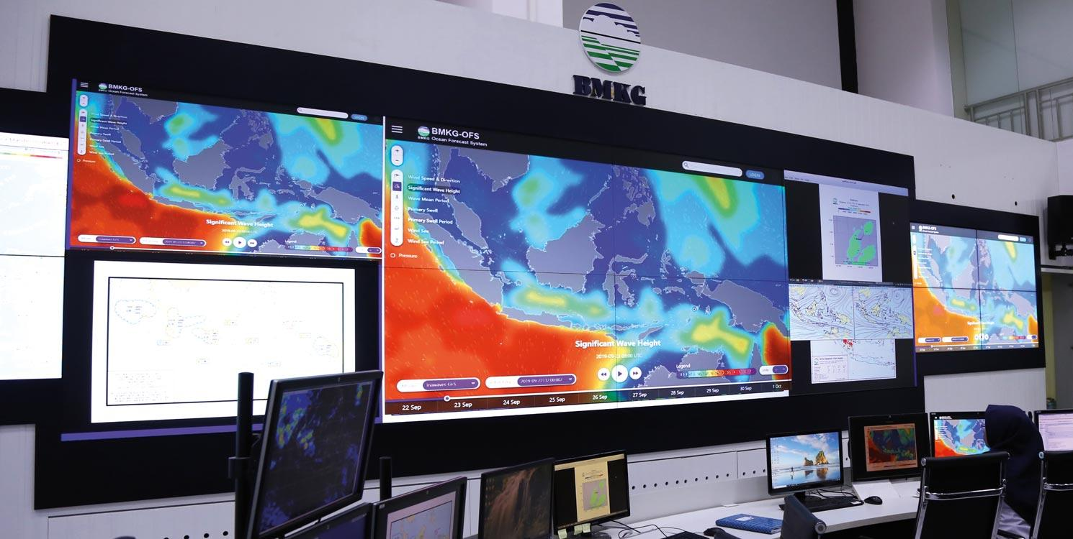
WMO-No.834 : Guide to Public Weather Services Practices
…..
INTERNATIONAL REGULATIONS, Minggu ke Empat Belas /M8C
Pertemuan 14- Selasa, 06 Juli 2026
DR. fachri Radjab
Maman Sudarisman

Slide 2
OUTLINE
INTRODUCTION
BENEFITS OF PUBLIC WEATHER SERVICES
ROLE OF PUBLIC WEATHER SERVICES
USER FOCUS AND SERVICE DELIVERY
WEATHER WARNING SERVICES
WEATHER FORECAST AND INFORMATION SERVICES
DISSEMINATION AND PRESENTATION
VERIFICATION, SERVICE EVALUATION AND IMPROVEMENT

Slide 3
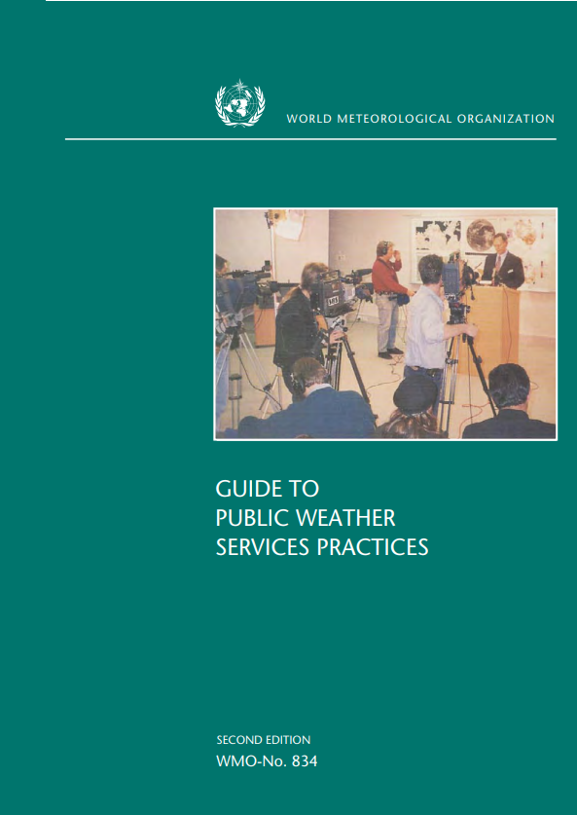
INTRODUCTION
This guide main purpose is to assist WMO Members with the development and improvement of weather services to the general public. It contains information about those practices and procedures which are of greatest importance for providing meteorological services to the public.
Source: https://library.wmo.int/records/item/31935-guide-to-public-weather-services-practices?offset=27

Slide 4
WMO Public Weather Services Programme
The purpose of the WMO PWS Programme is to assist WMO Members to provide reliable and effective weather and related services for the benefit of the public.
The main long-term objectives of the PWS Programme are:
To strengthen Members’ capabilities to meet the needs of the community through the provision of comprehensive weather and related services, with particular emphasis on public safety and welfare;
To foster a better understanding by the public of the capabilities of national Meteorological Services and how best to use their services.
Basic services funded by governments commonly take the form of weather warnings, forecasts and other information products which are distributed to the public through various media.

Slide 5
BENEFITS OF PUBLIC WEATHER SERVICES
The importance of the contribution of public weather services to the safety and well-being of the world’s peoples is illustrated not only by economic gains, but especially in the major reductions in loss of life and property damage due to natural disasters in vulnerable regions of the globe following implementation of effective warning systems for severe weather.
The Benefits:
For rapid onset hazards such as tornadoes, severe thunderstorms, flash floods, extreme winds, storm surges and blizzards, early and timely warnings could save lives by providing the information necessary to move people out of harm’s way or to assist individuals in taking quick response measures;
As for longer lead time hazards such as droughts, early warnings and accurate prediction of drought can allow farmers to reduce stock on pasture and avoid wastage of seed unlikely to grow;
Generalized public weather services intended for the population at large can also be of significant value to weather-sensitive sectors of the economy such as agriculture, forestry, fishing and marine transportation, tourism and recreation;
Long-term (seasonal and climate) forecasts and information are of great value in farming decisions on the choice of pesticide or antibiotic, crop types and livestock types, irrigation systems and land usage.

Slide 6
ROLE OF PUBLIC WEATHER SERVICES
Support to disaster reduction
The NMS role, as the expert in warning and detection, is one of a resource contact and motivator.
Mitigation
The databases of NMSs are the basis for risk assessments and vulnerability analyses that aimed at reducing the occurrence of a disaster or reducing its impact.
Preparedness
Key aspects of preparedness are that citizens understand the hazards that may affect them and know how to respond in a predetermined; and that decision makers are trained to make the best use of meteorological information to minimize the potential for misinterpretation or misinformation.
Response
Response activities consist of the actual warning process, including detection of a hazard, dissemination of warnings and forecasts and communication of essential information.
Recovery
Provision of forecasts and post-disaster support to the public and emergency managers on weather events which could hamper recovery efforts
Conducting post-disaster assessments of the warning system to assist in future preparedness and mitigation actions

Slide 7
USER FOCUS AND SERVICE DELIVERY
It is important that the products and services provided by an NMS are those actually required by the users.
communication and consultation with users are needed to ascertain the products and services required.
Once user requirements are known, products and service programmes can be developed that will meet those requests as far as possible within the limits of resources and meteorological capability.
There are 4 Main Groups of Users:
There are three broad types of services in a Public Weather Services Programme:
The hazards community
Governmental authorities (other than those dealing with hazards)
Weather-sensitive economic sectors
The public
Warnings
Forecasts
Information
Real-time products

Slide 8
WEATHER WARNING SERVICES
Weather warnings are the most vital component of all public weather services programmes from a public safety perspective.
Meteorologists and hydrologists have a crucial role to play in the entire process of dealing with natural disasters due to meteorological or hydrological events, but scientific knowledge alone will not solve the problem.
Meteorological and hydrological agencies must become involved with other governmental organizations, local and national officials, emergency managers, local decision makers, the media, voluntary organizations, and weather-sensitive businesses (known collectively as the hazards community) to create effective preparedness plans, warning systems, mitigation strategies and public education programmes.
For a warning programme to be successful, make sure everyone at risk must:
Receive the warning;
Understand the information presented;
Believe the information;
Personalize the risk;
Make correct decisions;
Respond in a timely manner,

Slide 9
WEATHER FORECAST AND INFORMATION SERVICES
Common variables/phenomena in public forecasts :
Timescale of forecasts :
Precipitation;
Wind;
Temperature;
Humidity;
Visibility;
Sky condition;
Nowcasting (0-2 hours forecasts)
Very short-range weather forecasting (to 12 hours forecasts)
Short-range weather forecasting (12-72 hours forecasts)
Medium-range weather forecasting (72-240 hours forecasts)
Extended-range weather forecasting10-30 days forecasts)
Long-range forecasting (30 days up to 2 years)
Monthly outlook
3 month or 90days outlook
Seasonal outlook
Climate forecasting (beyond two years)
Climate variability prediction
Climate prediction

Slide 10
DISSEMINATION AND PRESENTATION
There is no point in producing warnings, forecasts and information unless they can be disseminated rapidly to the public.
Previously, the most common means of dissemination were mass media, including television, radio, and newspapers. However, now that the internet is widespread and commonly used, online platforms such as the NMS's official website and social media have become more relevant.
There are several types of products through which warnings, forecasts, and information can be disseminated:
In times of severe weather a forecasting office may be inundated with telephone calls from television and radio stations for information and interviews on the situation. This can be overcome by calling a press conference, to be attended by all interested media when all can be informed at the same time.
Press conferences are also useful in highlighting meteorological events of a non-immediate nature, such as a forecast drought from an El Niño episode, or the prospects for a break in a drought.
Text product;
Audio product;
Visual product;
Animation;
Tabulated data;
others.

Slide 11
VERIFICATION, SERVICE EVALUATION AND IMPROVEMENT
Verification:
Ensuring that products such as warnings and forecasts are accurate and skillful from a technical point of view.
Service
Evaluation:
Ensuring that the services and products provided are meeting the users’ requirements, that they are well perceived by the users, and that the users are fully satisfied with the products themselves.
Evaluation:
User requirements: Do the products fully meet the needs of the users?
User satisfaction: Are the users satisfied with the format of the products, the means of dissemination?
User perception: Does the user understand the content of the services? Does the user have trust in
the products of the NMS and see them as credible?
Several method to assess users needs, satisfaction, and perception:
Surveys;
Worshops;
Other forms of direct contact (public relations campaign, speeches/visits at school, community meetings, etc)

